Slide 1
AT A GLANCE
© TU Wien | Matthias heisler/goemb.at
www.tuwien.at

Slide 2
mission
© TU Wien | Matthias heisler/goemb.at

Slide 3
‘Technology for people’
TU Wien is Austria’s largest research and educational institution in the field of technology and natural sciences.
Here, over 4,000 academics are working on ‘technology for people’ in five key areas of research across eight faculties.
The content of the courses offered is based on the excellent research, benefiting around 26,000 students in 62 courses of study. As a driver of innovation, TU Wien strengthens Vienna’s status as an economic hub, enables collaboration and contributes to the prosperity of society as a whole.

Slide 4
‘Technology for people’ | Research and Teaching
The research at TU Wien is constantly developing and rests on two pillars:
basic research differentiated according to discipline
application-oriented university research
In its teaching, TU Wien places great value on communicating not only principles but also the ability to acquire knowledge. Students are therefore involved in ongoing research projects. A major focus in these activities is equal opportunity. All members of TU Wien must have the opportunity to realise their full potential. For this reason, women in particular are supported, as they are typically underrepresented in technical fields.

Slide 5
Research and innovation
© TU Wien

Slide 6
Research Matrix
Much of the research activities are organised into a research matrix. The areas of focus have been removed from the faculty structure and are reflected in TU Wien fields of research. These, in turn, represent cross-faculty areas of expertise.

Slide 7
Research Matrix
Computational Science and Engineering | Quantum Physics and Quantum Technologies | Materials and Matter | Information and Communication Technology | Energy and Environment | Additional Fields of Research
Computational Materials Science | Photonics | Surfaces and Interfaces | Logic and Computation | Energy Active Buildings, Settlements and Spatial Infrastructures | Development and Advancement of the Architectural Arts
Computational Fluid Dynamics | Quantum Metrology and Precision Measurements | Materials Characterisation | Computer Engineering and Software-Intensive Systems | Sustainable and Low Emission Mobility | Urban and Regional Transformation
Computational System Design | Quantum Modeling and Simulation | Metallic Materials | Automation and Robotics | Climate Neutral, Renewable and Conventional Energy Supply Systems | Fundamental Mathematics Research
Mathematical and Algorithmic Foundations | Nanoelectronics | Non-metallic Materials | Information Systems Engineering | Environmental Monitoring and Climate Adaption | Mathematical Methods in Economics
Computer Science Foundations | Design and Engineering of Quantum Systems | Composite Materials | Visual Computing and Human-Centered Technology | Efficient Utilisation of Material Resources
Modeling and Simulation | Quantum Many-Body Systems Physics | Biological and Bioactive Materials | Digital Transformation in Manufacturing | Sustainable Production and Technologies
 |  | Special and Engineering Materials | Telecommunications
 |  | Structure-Property-Relationship | Sensor Systems

Slide 8
Research Focal Areas
Research at TU Wien is focused on five key areas. These five pillars represent the strengths and skills of TU Wien going back many years, and they strengthen its profile in international competition. Within these key areas, work is carried out on an interdisciplinary basis and the research spectrum is constantly being developed.
Computational Science and Engineering
Quantum Physics and Quantum Technologies
Materials and Matter
Information and Communication Technology
Energy and Environment
Additional Fields of Research

Slide 9
Research Focal Area in Detail: Computational Science and Engineering
Computational Materials Science
Computational Fluid Dynamics
Computational System Design
Mathematical and Algorithmic Foundations
Computer Science Foundations
Modeling and Simulation

Slide 10
Computational Science and Engineering
TU Wien is researching the technological principles of information processing, with the aim of enabling innovative applications to be developed within computer engineering.
The topics covered range from mathematical foundations to the development of electronic hardware and the simulation of highly complex systems.
For model calculations and simulations, TU Wien has access to an extremely powerful large-scale computer, the VSC-5 (98.560 Cores, 4.3 PFlop/s).
© TU Wien | Matthias heisler/goemb.at

Slide 11
Research Focal Area in Detail: Quantum Physics and Quantum Technologies
Photonics
Quantum Metrology and Precision Measurements
Quantum Modeling and Simulation
Nanoelectronics
Design and Engineering of Quantum Systems
Quantum Many-body Systems Physics

Slide 12
Quantum Physics and Quantum Technologies
Quanta play a key role in physics, chemistry as well as electrical engineering and quantum technologies, such as microchips and sensors, have already become commonplace. TU Wien is researching other possible applications of quantum phenomena, ranging from fundamental interactions between elementary particles, sources of radiation for ultra-short photon pulses, to the control of the states of individual atoms and components for quantum computers.
© ÖAW

Slide 13
Research Focal Area in Detail: Materials and Matter
Surfaces and Interfaces
Materials Characterisation
Metallic Materials
Non-metallic Materials
Composite Materials
Biological and Bioactive Materials
Special and Engineering Materials
Structure-Property-Relationship

Slide 14
Materials and Matter
Research is being conducted into everything from the nano-world to the development of new materials for large-volume applications.
Work is conducted both on a theoretical basis – for instance, with mathematical models on computers – and on an experimental basis, with the development and testing of innovative materials.
Researchers in this field are also puzzling over the phenomenon of superconductivity.

Slide 15
Research Focal Area in Detail: Information and Communication Technology
Logic and Computation
Computer Engineering and Software-Intensive Systems
Automation and Robotics
Information Systems Engineering
Visual Computing and Human-Centered Technology
Digital Transformation in Manufacturing
Telecommunications
Sensor Systems

Slide 16
Information and Communication Technology
To help the digital world become more people-friendly, secure and intelligent, TU Wien is researching and developing new information and communication technologies. Hardware and software are both included in the research, as they are often impossible to separate. In addition to technological principles, the economic, social and cultural integration of information and communication technology is also being investigated.
© IKT

Slide 17
Research Focal Area in Detail: Energy and Environment
Energy Active Buildings, Settlements and Spatial Infrastructures
Sustainable and Low Emission Mobility
Climate Neutral, Renewable and Conventional Energy Supply Systems
Environmental Monitoring and Climate Adaption
Efficient Utilisation of Material Resources
Sustainable Production and Technologies

Slide 18
Energy and Environment
Researchers from various fields are working together to tackle major social issues, including:
How can new energy sources be developed?
How can the energy supply be ensured?
How can energy be stored and used efficiently?
As well as others: How can technologies become more sustainable?
Technical knowledge is built on expertise in climate, the environment, the economy and raw materials.
© Tu wien

Slide 19
Research Focal Area in Detail: Additional Fields of Research
Development and Advancement of the Architectural Arts
Urban and Regional Transformation
Fundamental Mathematics Research
Mathematical Methods in Economics

Slide 20
Additional Fields of Research
In addition to the five focal areas, TU Wien has additional important fields of research. These include certain areas of mathematics and economics as well as architectural aspects.

Slide 21
Academic affairs
© TU Wien | Matthias Heisler/goemb.at

Slide 22
Studying
Studying at TU Wien means gaining a broad range of basic knowledge whilst simultaneously being given the opportunity to specialise according to subject and interest.
TU Wien places great importance on involving students in current research programmes. The university offers a broad spectrum through its 18 Bachelor, 41 Master and 3 Doctoral study programmes and its many university courses.
Around 26,000 students are already taking advantage of this spectrum.

Slide 23
Number of Students
As of 2022, source: Center for Strategic Education Development Center

Slide 24
Number of Students: beginners and degrees in comparison
beginners degrees
As of January 2022, source: Center for Strategic Education Development Center

Slide 25
TUW Community

Slide 26
Network, share, collaborate
TU Wien is a place of encounter, a place where young and old exchange ideas at eye level, share memories and look forward to the future together.
Immerse oneself in the diversity of the TU Wien community – in teaching, research, continuing education and kulTUr: get to know TUW anew, network and work together. "Together we are TU Wien"
https://www.tuwien.at/en/community

Slide 27
TU Wien Space Team
… is a student working group for aerospace engineering and develops small satellites, aerospace engines, experimental rockets, and much more.
The team participates in international competitions, makes record attempts and has sent its own hardware into space.
© Tu wien space team
https://spaceteam.at/en

Slide 28
TU Wien Racing Team
… is made up of students and has had success at countless international competitions with self-constructed vehicles.
© Tu wien racing team
www.racing.tuwien.ac.at

Slide 29
TU Robots
… is the official sports team of TUW and HTU Wien, representing the university in basketball, football and cheerdance in the Austrian College Sports League.
© markus Rist
www.acsl.at

Slide 30
IAESTE Vienna
... is an internationally active student organisation that arranges subject-specific internships for students studying technical and scientific subjects.
At TU Wien, IAESTE organises company fairs and the company shuttle in addition to supporting companies and interns.
https://www.iaeste.at/en/

Slide 31
TU choir
… has already achieved considerable success at choir competitions as well as on television in the ORF casting show "Die Große Chance der Chöre".
In 2018 a gold medal was sung at the World Choir Games, the Olympic Games of Choirs, in South Africa. Repertoire are well-known pop songs and timeless ballads.
© Matthias Muggli
https://www.tuwien.at/en/chor

Slide 32
TU Orchester
Founded in 1984, it is the first and oldest university orchestra in Vienna.
The orchestra has since become the musical calling card of the TU Wien: through regular concert activities, the opening of the traditional TU Ball and the framing of academic celebrations.
© jurecka
https://tuorchester.at/en

Slide 33
Academic Vienna Philharmonic Orchestra
Founded in 1994 and based at TU Wien, the Akademische Bläserphilharmonie consists mainly of students and graduates from TU Wien, but also from other Viennese universities. It also comprises many dedicated musicians from a wide range of professional and age groups.
© Tu wien
www.blaeserphilharmonie.at

Slide 34
PARTNERSHIPS
© TU Wien

Slide 35
Partnerships
Partnerships are institutionalised at TU Wien in competence centers, networks and projects.
In addition, the TU Wien has a major role in the Austrian Science Fund’s (FWF).
© TU Wien

Slide 36
Partnerships
In the field of applied research, TU Wien is represented in a range of programmes and initiatives at the Austrian Research Promotion Agency (FFG) and takes on a coordinating role in some areas (e.g. COMET programme, R&D infrastructure).
It is the leading Austrian university at the laboratories of the Christian Doppler Research Association (CD laboratory).
© TU Wien

Slide 37
Development of Third Party Funds
As of 2022, source: Intellectual Capital Report 2022

Slide 38
Tuw international
© TU Wien

Slide 39
Internationalisation
TU Wien pursues a cosmopolitan approach and considers itself to be part of a globally interconnected research and education landscape.
Internationalisation also helps to increase the quality of research, teaching and services, and is therefore actively embraced at TU Wien. This is reflected in the organisation of and participation in international teaching and research programmes and collaborations as well as multilateral university networks. Almost a third of its students and research staff originate from outside Austria.

Slide 40
Internationalisation strategy
TU Wien therefore pursues a strategy of successful international networking. This includes:
Forming bilateral university partnerships to take advantage of regional and subject-based strengths
Securing an attractive, intercultural teaching and research environment at TU Wien
Promoting the mobility of students, teaching staff and researchers
Developing suitable marketing strategies to increase international visibility and attract the ‘best minds’.

Slide 41
DIGITALISATION

Slide 42
Digitalisation
As a technical university, TU Wien is best placed to continue to advance its role as an innovative driver of digital transformation within society.
The focus is on:
Digitalisation in research
Digitalisation in teaching
Digitalisation in administration

Slide 43
Digitalisation in research
Digitalisation is a source of enormous potential, particularly at a university of technology. For TU Wien this potential lies in the area of the six key enabling technologies (KETs) identified by the European Commission:
Micro and Nanoelectronics
Nanotechnology
Industrialbiotechnology
Advanced Materials
Photonics
Advanced Manufacturing Technologies

Slide 44
Digitalisation in teaching
The aim is for students not just to use digital technologies as consumers, but also to gain a basic understanding of how they can actively participate in the innovation process.

Slide 45
Digitalisation in administration
Implementing a centrally controlled digitalisation strategy requires the development and establishment of the necessary infrastructure as well as the adaptation of the organisational structure.
The TU Wien administration department has already implemented digitalisation measures in countless administrative processes and will continue the swift digitalisation of all administrative processes.

Slide 46
.digital office
The .digital office service unit is coordinating the operational implementation of this digitalisation strategy. In doing so, the .digital office is responsible for the central moderation and configuration of the implementation measures and specific digitalisation projects.

Slide 47
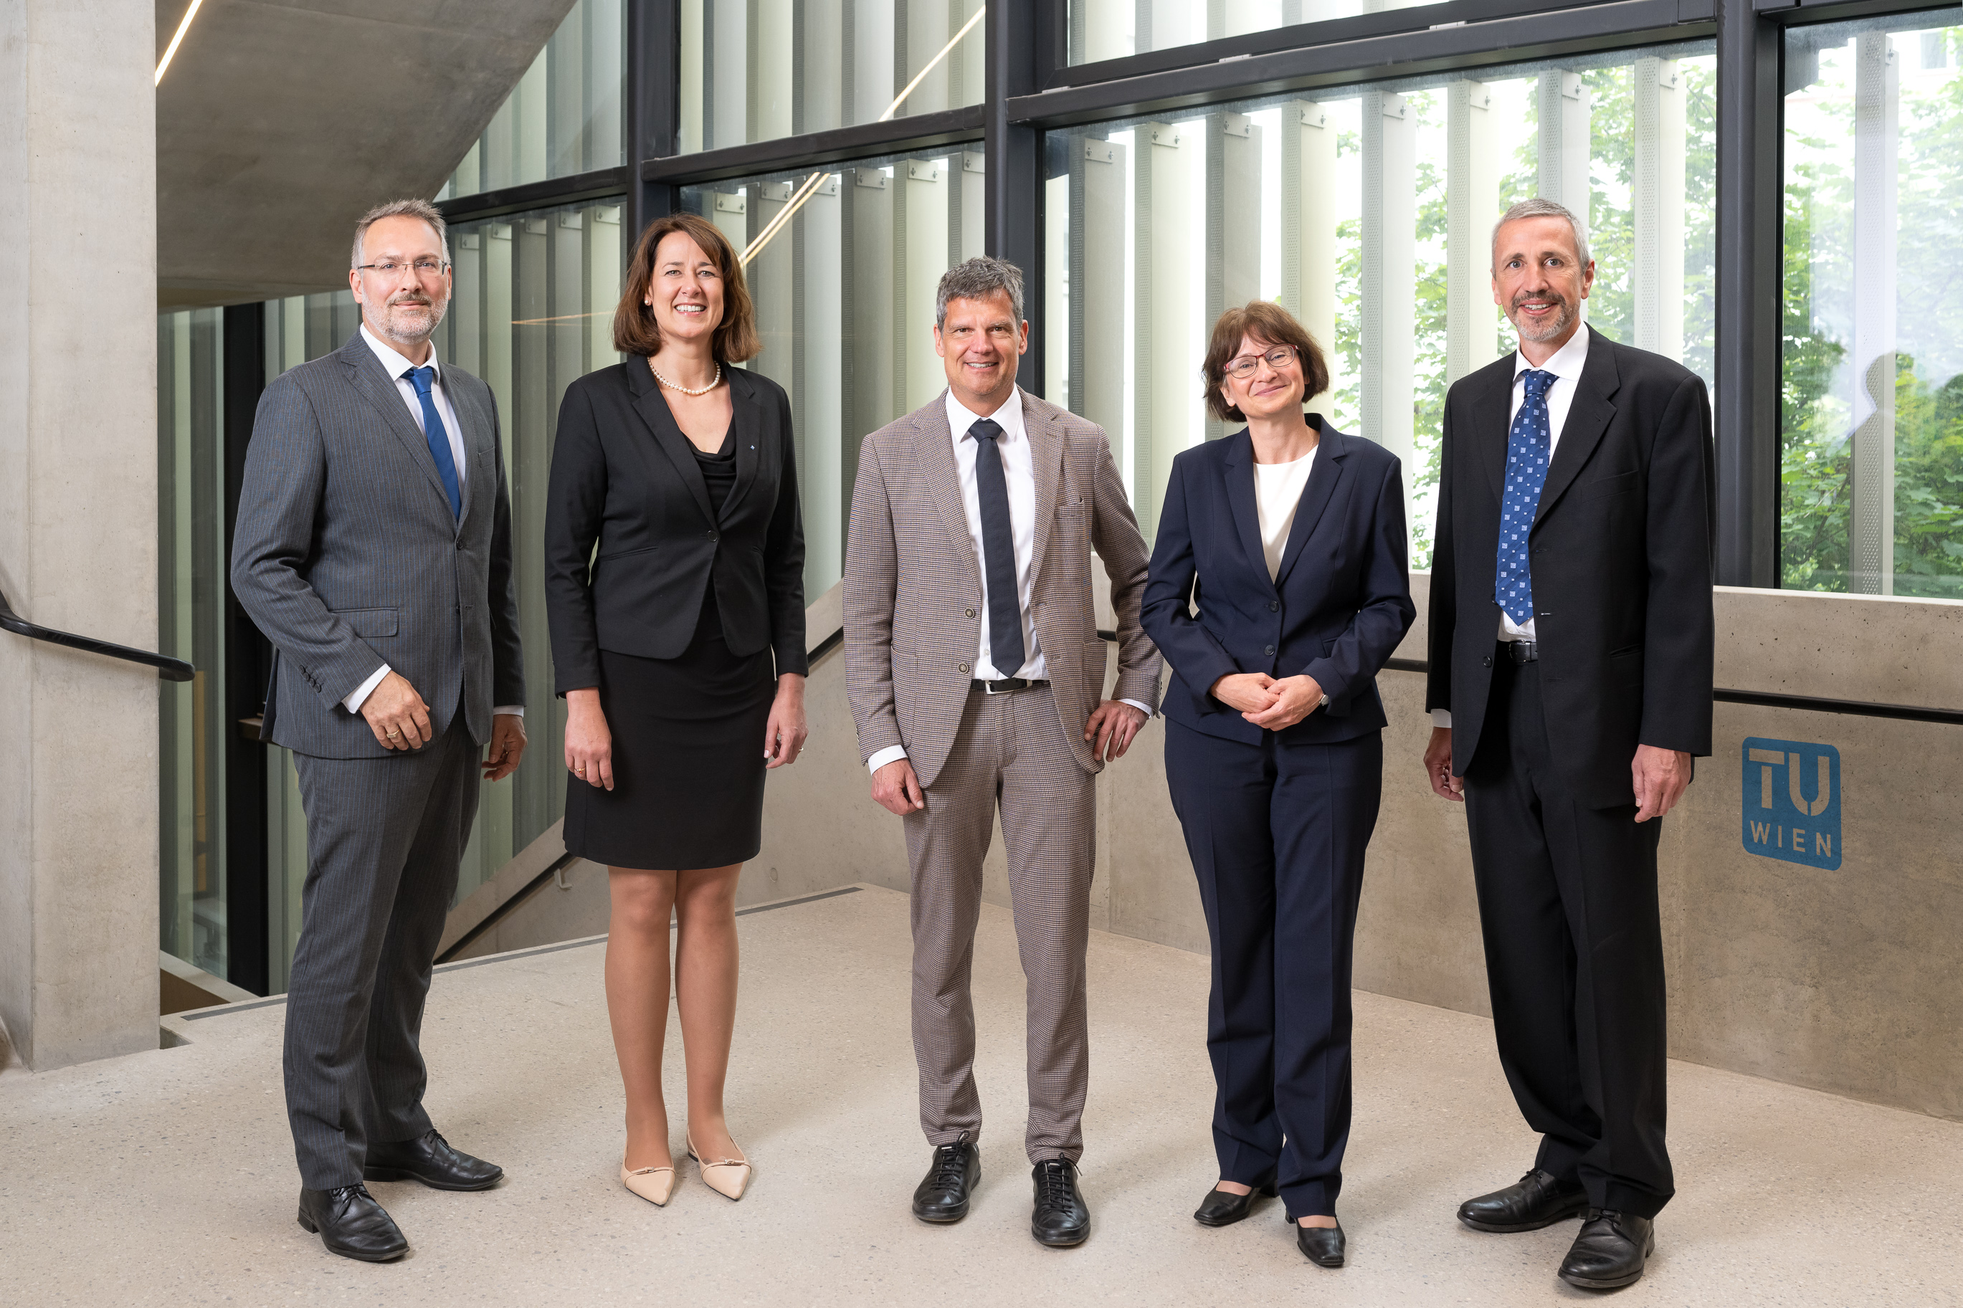
organisation
© TU Wien | Matthias Heisler/goemb.at

Slide 48
Organisation
Since universities were granted autonomy by the Austrian Universities Act, TU Wien has been managed by the Rector’s Office, the University Council and the Senate. The Rector’s Office runs TU Wien and represents it externally.
It is made up of the rector and four vice rectors. The University Council is the supreme supervisory body at TU Wien. The Senate is made up of representatives of university professors and lecturers as well as academic members of staff, general university staff and students.

Slide 49
Rectorate
© TU Wien | Matthias Heisler/goemb.at
Peter Ertl
VR Research,
Innovation, International Affairs
Jasmin Gründling-Riener
VR Academic Affairs
Jens Schneider
Rector
Ute Koch
VR Human Resources
Wolfgang Kastner
VR Digitalisation & Infrastructure
The Rector’s office is responsible for the strategical and operational management and has five members.

Slide 50
Jens Schneider, Rector
Financial Department
PR & Fundraising
Internal Audit
University Development & Quality Development
Services Rector
© TU Wien

Slide 51
Peter Ertl, VR Research, Innovation, International Affairs
Facilities und Centers
RTI Support (Research, Technology, Innovation)
Services VR Research, Innovation, International Affairs
© TU Wien

Slide 52
Jasmin Gründling-Riener, VR Academic Affairs
Academy for Continuing Education
Doctoral School
Strategic Education Development Center
Admission Office
International Office
Services Academic Affairs
© TU Wien

Slide 53
Wolfgang Kastner, VR Digitalisation & Infrastructure
Real Estate & Facility Management
Information Technology Solutions
Library
Campus Software Development
Data Protection & Document Management
Archives
Low Temperature Facilities
Services VR Digitalisation & Infrastructure
© TU Wien

Slide 54
Ute Koch, VR Human Resources
Gender Competence
HR Administration
HR Development
Services VR Human Resources
© TU Wien

Slide 55
Faculties
8 faculties with 51 institutes cover the classic engineering and scientific fields.
Architecture and Planning
Civil and Environmental Engineering
Electrical Engineering and Information Technology
Informatics
Mechanical and Industrial Engineering
Mathematics and Geoinformation
Physics
Technical Chemistry

Slide 56
University Council
from the left:
Mag. Andrea REITHMAYER, Chairwoman of the Supervisory Board ÖBB-Holding AG
Univ.-Prof. DI Dr. Dr.h.c.mult. Martin GERZABEK, President Christian Doppler Forschungsgesellschaft
Univ.Prof. Dr.-Ing. Heribert NACKEN, Chair of Engineering Hydrology UNESCO Chair of Hydrological Change and Water Resources Management RWTH Aachen University
DI Dr. Barbara OBERHAUSER, Senior Vice President and Head HSEF, NAYARA Energy
Univ. Prof. Dr. Johanna STACHEL (Vice Chairwoman), Institute of Physics, University of Heidelberg
MMag. Peter OSWALD (Chairman), Chairman of the Board Mayr-Melnhof Karton AG
DI Dr. Iris FILZWIESER, Shareholder and Managing Director METTOP GmbH
Notes:
Der Universitätsrat besteht aus 7 Mitgliedern aus Wirtschaft und Wissenschaft. Er fungiert als Aufsichtsrat.

Slide 57
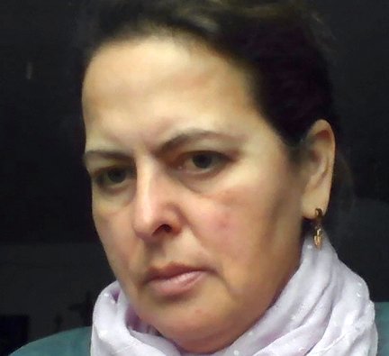
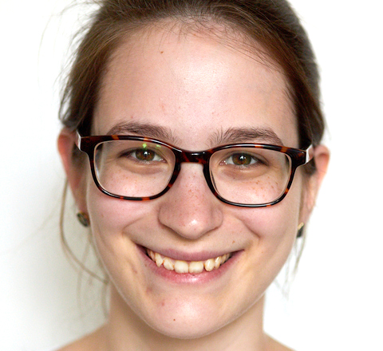
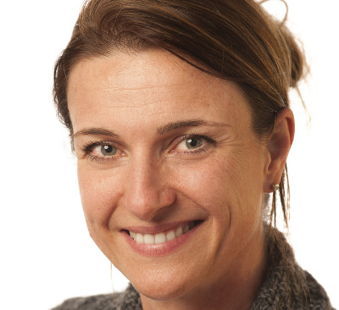
Senate Chairpersons
The Senate is the highest collegiate body and consists of 26 representatives from the various groups within the university.
The Senate takes on monitoring, advisory, legislative and strategic management tasks at TU Wien.
https://www.tuwien.at/en/tu-wien/organisation/university-management/senate
Norbert pfeifer Chairman of the Senate © © thomas Blazina
Karin Poljanc 1. VICE CHAIRWOMAN of the senate © TU Wien
KATHARINA KRALICEK 2. VICE CHAIRWOMAN of the senate © privatE
MARTINA MARCHETTI-DESCHMANN 3. VICE CHAIRWOMAN of the senate © privatE

Slide 58
Diversity
© Tu Wien | Matthias Heisler/goemb.at

Slide 59
Diversity …
… denotes the similarities and differences between people or groups.
These can be considered at an individual, institutional as well as structural level and affect all people equally.

Slide 60
TU Diversity-Management
TU Wien makes sure that all members of the university, with all their similarities and differences, are supported wherever they find themselves in life and whichever career path they have chosen.
The TU Diversity Management initiative aims to create a positive atmosphere at TU Wien, prevent social discrimination amongst staff and students and improve equal opportunities, based on the belief that a diverse workforce is the best resource for enabling the flexibility, innovation and creativity necessary for technical, university and social processes.

Slide 61
Gender
At TU Wien, the advancement of women is reflected in the establishment of positive, career-promoting conditions for women. The goal is to make sure that all genders at TU Wien are given opportunities for development in line with their qualifications and that existing disadvantages for women are eliminated or levelled out.
The responsibilities of the TUW Gender Competence Service Department extend to the areas of gender studies and research, gender equality, female-specific personnel development for colleagues, promotion measures for pupils, students and junior scientists, as well as consultancy services.

Slide 62
Barrier-free access
Since 1996 TU Wien provides a point of contact and support for students whose studies are affected by a disability or illness. Employees can contact the disability representative.
Students with disabilities are required to meet the same prerequisites as all other TU students. However, when they encounter barriers as a result of their disability, the disabilities officer tries to counterbalance this with advice and support.

Slide 63
Tuw as aN Employer
© TU Wien | Matthias Heisler/goemb.at

Slide 64
TUW as an employer
With more than 5,000 employees, TU Wien is Austria’s largest research and educational institution in the field of technology and natural sciences.
More than 4,000 scientists conduct research at eight faculties with five different areas of research.
The content of the courses offered in the traditional fields of engineering and natural sciences is based on excellent research, benefiting around 26,000 students in 62 courses of study.

Slide 65
TUW as an employer
In addition to this, TU Wien is constantly striving to ensure family-friendly conditions at the university.
This is underlined by the fact that it has signed the ‘Family at university’ charter and has joined ‘Companies for families’ as a network partner.
Staff development at TU Wien provides support to new employees on their arrival by means of an induction (‘Onboarding’) programme. Awards such as "most family-friendly university" or the "HR Award" confirm the commitment.

Slide 66
History

Slide 67
History
TU Wien has its origins at Karlsplatz in the centre of Vienna. It was founded in 1815 under the name ‘k. k. polytechnisches Institut in Wien’.
On 4 April 1805, Emperor Franz II (I) (1768–1835) instructed the Imperial Commission on Education to produce a report on the question of establishing a polytechnic institute in Vienna. In March 1810, Johann Joseph Prechtl (1778–1854) was appointed to develop an organisation plan and course programme.
After countless revisions, the draft received imperial approval on 31 August 1817.
Prechtl himself was appointed the director of the future educational institution on 24 December 1814.

Slide 68
Milestones 1815–1975
1815 Foundation as Imperial and Royal Polytechnic Institute
1865 First reform, rectorial constitution, divided into 5 faculties
1872 Name changed to Technical University
1909 First doctorates confered
1919 Women admitted as regular students
1975 Name changed to University of Technology

Slide 69
Meilensteine 2004–2019
2004 Autonomy
2006 Decision to remain at the current location
2011 First female rector: Sabine Seidler
2015 200 year anniversary
2019 Celebrating 100 years of women admitted as regular students

Slide 70
TU WIEN Alumni make history

Slide 71
Christian Doppler
Joined the Imperial and Royal Polytechnic Institute as an Assistant in 1829.
Gave his name to the Doppler effect.
© ÖNB/Wien

Slide 72
Richard Zsigmondy
Student at the Technical University of Vienna from 1883.
Awarded the Nobel Prize for Chemistry in 1926.
© ÖNB/Wien

Slide 73
Viktor Kaplan
Studied Mechanical Engineering at the Technical University from 1895.
Gave his name to the Kaplan turbine (hydroelectric power stations).
© ÖNB/wien

Slide 74
Heinz Zemanek
Studied Communications Technology at the Technical University from 1937.
He built one of the first fully transistorised computers, called ‘Mailüfterl’.
© tu wien

Slide 75
Franz Viehböck
Graduated from TUW with a degree in Electrical Engineering, first (and so far the only) Austrian astronaut.
Currently on the Board of Berndorf AG.
© franz viehböck

Slide 76
Judith Engel
Studied Civil Engineering at TUW.
Project leader in the construction of Vienna’s Central Railway Station. Head of ÖBB Infrastruktur AG from 2022.
© Matthias Heisler |goemb.at

Slide 77
Barbara Oberhauser
Studied Technical Chemistry at TUW.
Senior Vice President and Head HSEF, NAYARA Energy
© omv ag

Slide 78
Susanna Zapreva
Graduated in Electrical Engineering at TU Wien.
She is currently CEO of enercity AG.
© wien energie/ian ehm

Slide 79
Anna Kiesenhofer
Studied mathematics and physics at TU Wien.
She became famous for her victory in the road race at the Olympic Games in Tokyo 2021.
© anna kiesenhofer

Slide 80
Ferenc Krausz
In 2023, Ferenc Krausz was awarded the Nobel Prize in Physics for his fundamental research in laser optics.
In its citation, the Nobel Prize Committee specifically mentioned the experiments he carried out at TU Wien. Ferenc Krausz has been Director of the Max Planck Institute of Quantum Optics in Garching since 2003.
© TU Wien | Matthias heisler/goemb.at

Slide 81
Locations

Slide 82
Locations
The TU Wien is developing into a modern city campus at its historically grown location. It currently comprises four inner city locations and three additional research sites in Vienna.
TUW Maps unter www.tuwien.at/maps

Slide 83
Karlsplatz
Inner city location
Campus Karlsplatz
Karlsplatz 13,
1040 Wien
TUW Maps unter www.tuwien.at/maps
© TU Wien

Slide 84
Getreidemarkt
Inner city location
Campus Getreidemarkt
Getreidemarkt 9,
1060 Wien
TUW Maps unter www.tuwien.at/maps
© skylens wien

Slide 85
Gußhaus
Inner city location
Campus Gußhaus
Gußhausstraße 25–29,
1040 Wien
TUW Maps unter www.tuwien.at/maps
© lukas schaller

Slide 86
Freihaus
Inner city location
Campus Freihaus
Wiedner Hauptstraße 8–10,
1040 Wien
TUW Maps unter www.tuwien.at/maps
© peter haas

Slide 87
Pilotfabrik
Pilotfabrik Industry 4.0
Seestadtstraße 27,
1220 Wien
TUW Maps unter www.tuwien.at/maps
© TU Wien | Matthias heisler/goemb.at

Slide 88
Science Center
Science Center at Arsenal
Franz-Grill-Straße,
1030 Wien
TUW Maps unter www.tuwien.at/maps
© TU Wien | Matthias heisler/goemb.at

Slide 89
Atominstitut
Atominstitut
Stadionallee 2,
1030 Wien
TUW Maps unter www.tuwien.at/maps
© TU Wien | Matthias heisler/goemb.at

Slide 90
Editing and Layout PR & Marketing
Contakt +43 1 58801 41024 | pr@tuwien.ac.at
Status 10/2023
tu wien
tu_wien
tuwientv
tuwien
tu_wien
Vienna Scientific cluster vsc-4

