Slide 1
It’s Happening, so What?
Julia Neidhardt
Research Unit of E-Commerce
TU Wien, Austria
julia.neidhardt@tuwien.ac.at
http://www.ec.tuwien.ac.at/neidhardt/

Slide 2
Informatics
Digital transformation shows pervasive role of Informatics
Important for innovation, growth and wealth
Informatics has direct impact on (nearly) everything
Foundational – methods and artefacts
Metamorphosis from a computer to global machine
And every thing touched by Software becomes a Computer

Slide 3
Informatics (2)
Artificial Intelligence/Machine learning is automating working and decision making
Discussions between Utopia and Dystopia
Neural networks as current paradigm of AI: Roy Amara (ITF's president) with his “law”: We tend to overestimate the effect of a technology in the short run and underestimate it in the long run
Many AI summers and winters since 50s
Current boom required related technology stack: processing power, memory, available/accessible data

Slide 4
Many Critical Issues
Personalization
Ubiquitous and absolutely required to counteract information overload
Implicit personality acquisition: By analyzing user behavior and user generated content, it is possible to gain deep knowledge about a user – even about the user’s personality (“Big Five” traits)
Micro-blogs (Twitter)
Social media (Facebook, Weibo)
Games
Mobile phone logs
Stereotypical stories
Selected pictures
→ High danger of misuse (remember Cambridge Analytica!)
“Big Five” traits:
Openness to experience
Conscientiousness
Extraversion
Agreeableness
Neuroticism
(Tkalcic & Chen 2015, Neidhardt et al. 2014)

Slide 5
Many Critical Issues (2)
Concentration and monopolies in the Web
Crucial in economic, political and even military conflicts, even autonomous weapons
Echo chambers and fake news (will social media become 5. power?)
Privacy
Automation and work
The system is failing, stated by Tim Berners-Lee
The Internet apologizes, Jaron Lanier, a pioneer in virtual reality
In April 2019 Vienna Workshop on Digital Humanism (www.informatics.tuwien.ac.at/dighum)

Slide 6
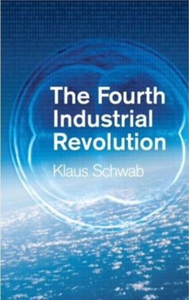
Which Way to Go?
4th Industrial Revolution vs. Surveillance Capitalism

Slide 7
Workshop on Digital Humanism
More than 100 participants, from Informatics, Philosophy, History, Anthropology, Law, Economics, Political Science, Mathematics, Sociology
Three main sessions:
History and Impact of Information Technology
Humans and Society, AI and Ethics
Dynamics of a New World – Issues and Answers
Presentations at website www.informatics.tuwien.ac.at/dighum

Slide 8
Vienna Manifesto on Digital Humanism
The manifesto is a call for reflection and action (addressed to science and decision makers), and it is also a research program
We should shape technologies in accordance with human values and needs instead letting technologies shape us
Some core principles:
Digital technologies should be designed to promote democracy and inclusion
Fairness, responsibility and transparency of software programs and algorithms
Action/intervention against tech monopolies
Decisions affecting human rights must be made by humans
The connection of different scientific disciplines is essential
Universities create new knowledge and enhance critical thinking; they have a particular responsibility
Academic and industrial researchers must maintain an open dialogue with society
Academic teaching needs to combine humanities, social sciences and engineering

Slide 9
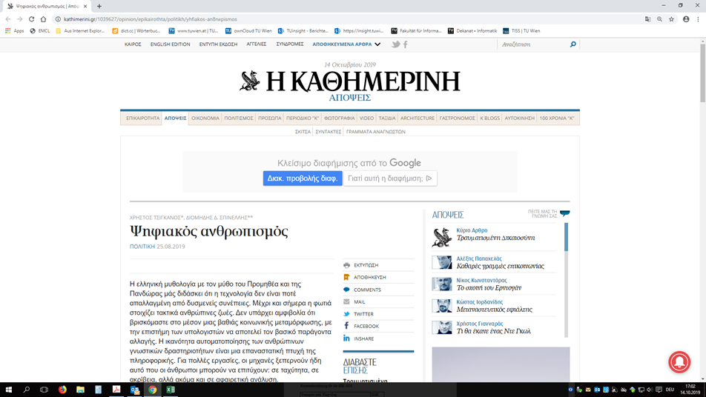
Impact
Manifesto – more than 600 signatures (42 countries) and 6 language versions
Research program in Vienna
Featured in major Greek newspaper “Kathimerini”

Slide 10
Impact (2)
DigHum lecture at TU Wien / Informatics
Interactive lecture with presentations, discussions and group work of students
Each group has an advisor / mix of disciplines (incl. philosophy)
Students deliver a final report / SW and publish their results on the web
Combined with a public lecture series with internationally renowned speakers (https://informatics.tuwien.ac.at/stories-1758)
06.11.2019 Susan J. Winter (University of Maryland) – “Cui Bono: A Sociotechical View of Smart Cities”
20.11.2019 Gerfried Stocker (Artistic Director of Ars Electronica) – “Humanizing Technology through Arts”
18.12.2019 Edward A. Lee (University of California at Berkeley) – “The Coevolution of Humans and Machines”
08.01.2019 Julian Nida-Rümelin (Ludwig-Maximilians-Universität Munich) – “Digitaler Humanismus”

Slide 11
Conclusions
Technology is not magic, it does not come from nowhere
Reflects specific interests and points of view
Need to understand and to reflect
But we can and must actively participate
Doing research in this field also implies a specific responsibility
We are at a crossroads
Popper (1969) “Moral Responsibility of the Scientist” http://www.unz.com/print/Encounter-1969mar-00052

Slide 12
Thank you!

