Slide 1
GEECCO Data Monitoring Tool
Tutorial – How to use the GEECCO Data Monitoring Tool (Excel Template)
February 23, 2021
Grant agreement No 741128

Slide 2
Content
GEECCO Data Monitoring Tool – Aim (slide 3)
Target Groups & Learning Objectives (slide 4)
Preconditions for optimal use of the GEECCO Data Monitoring Tool (slides: 5-6)
Step-by-Step Guide (slides 7-15)
Overview: Important indicators for gender analysis (slide 16)
Background Information – Tutorial Development (slide 17)

Slide 3
GEECCO Data Monitoring Tool - Aim
To serve as resource for collecting sex-disaggregated data and monitoring quantitative gender equality indicators at research performing organisations (RPOs)
To generate process data for monitoring the progress towards set gender equality targets
To provide various indicators showing progress towards gender equality targets in three thematic areas:
Decision-making processes and bodies,
Recruitment and career development of female researchers and staff members,
Gender dimension in research and teaching

Slide 4
Target Groups & Learning Objectives
Target Groups
Gender equality officers in research performing organizations (RPOs)
Gender Equality Activists, GEP Implementers, Change Agents
Learning Objectives
Acquiring knowledge on important indicators for gender analysis in RPOs
Acquiring knowledge on monitoring sex-disaggregated data in RPOs

Slide 5
Preconditions for Optimal Use I
Get an overview of the gender equality objectives and existing gender equality measures of your RPO.
Decide which sex-disaggregated process data you need to monitor the progress towards the set gender equality targets of your RPO.
The GEECCO Data Monitoring Tool provides indicators for the 3 thematic areas: decision-making bodies, recruitment and career development, gender dimension in research and teaching.
You can use the complete set of sex-disaggregated indicators monitoring the progress towards gender equality in all three thematic areas at your RPO.
You can also only use some of the sex-disaggregated indicators if your RPO aims to achieve gender equality objectives in one or two of the three thematic areas or if some data is not available, i.e., you can pick to monitor the indicators on which you want to follow up upon.

Slide 6
Preconditions for Optimal Use II
Identify types of data and possible sources of information to collect the required sex-disaggregated data at your RPO.
Get the permission needed from management to collect sex-disaggregated data at your RPO.
Collect the sex-disaggregated data on the chosen gender equality objectives and relating indicators regularly - at least every two years - at your RPO.
Use the same cut-off dates over the years for ensuring comparability of the collected data. For example, the year column "2020" refers to data for the year 2020. If December 31, 2020, is the cut-off date for the year 2020, December 31, 2021, should be the cut-off date for the year 2021.

Slide 7
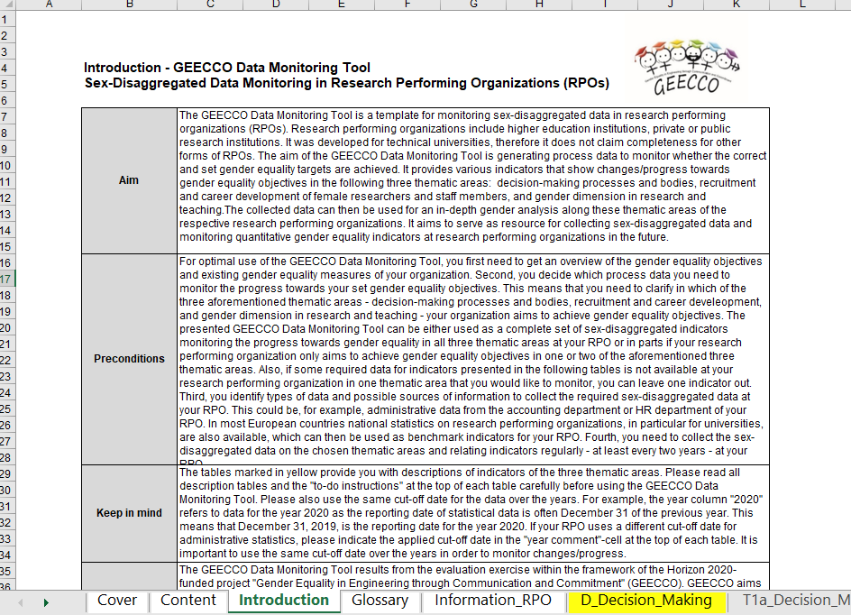
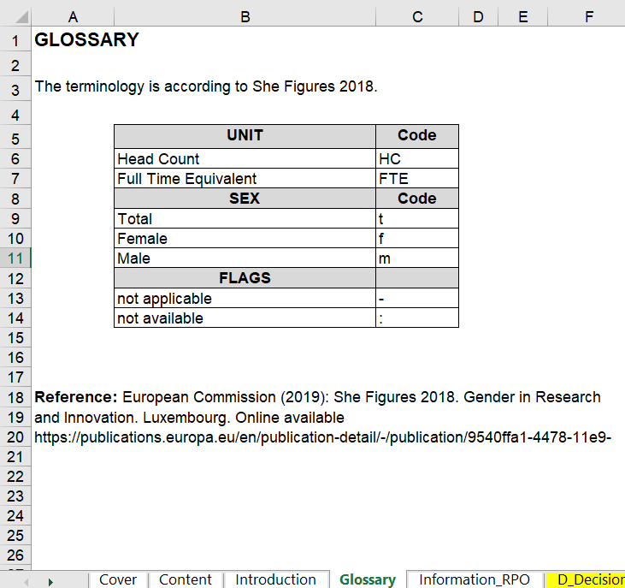
Step-by-Step Guide – Step I
Read the introduction and glossary sheets of the GEECCO Data Monitoring Tool.

Slide 8
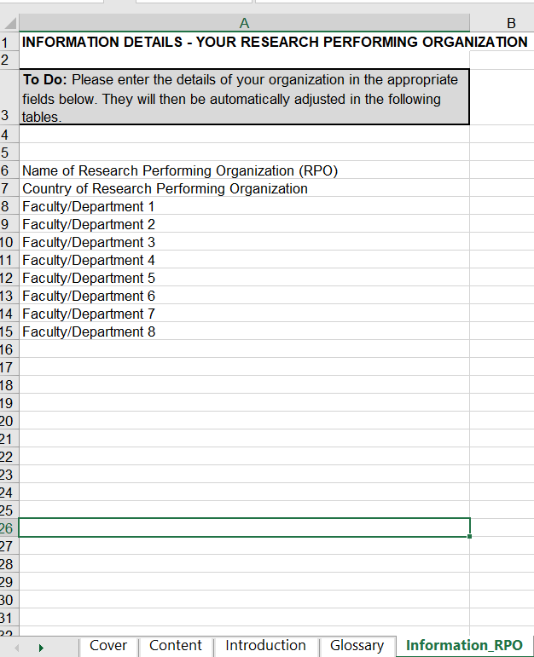
Step-by-Step Guide - Step II
Enter the details of your organization in the ‘Information_RPO’ sheet.

Slide 9
Step-by-Step Guide - Step III
Before starting to enter sex-disaggregated data, read the ‘description sheets‘ of indicators presented in the GEECCO Data Monitoring Tool. The description sheets are marked in yellow.
Due to the numerous indicators regarding the thematic area ‚recruitment and career development‘, several description sheets on this thematic area are included.
The following slides show examples of description sheets on indicators concerning the thematic areas ‚decision-making positions and bodies‘ and ‚recruitment and career development‘.

Slide 10
Description Sheets – Example I

Slide 11
Description Sheets – Example II

Slide 12
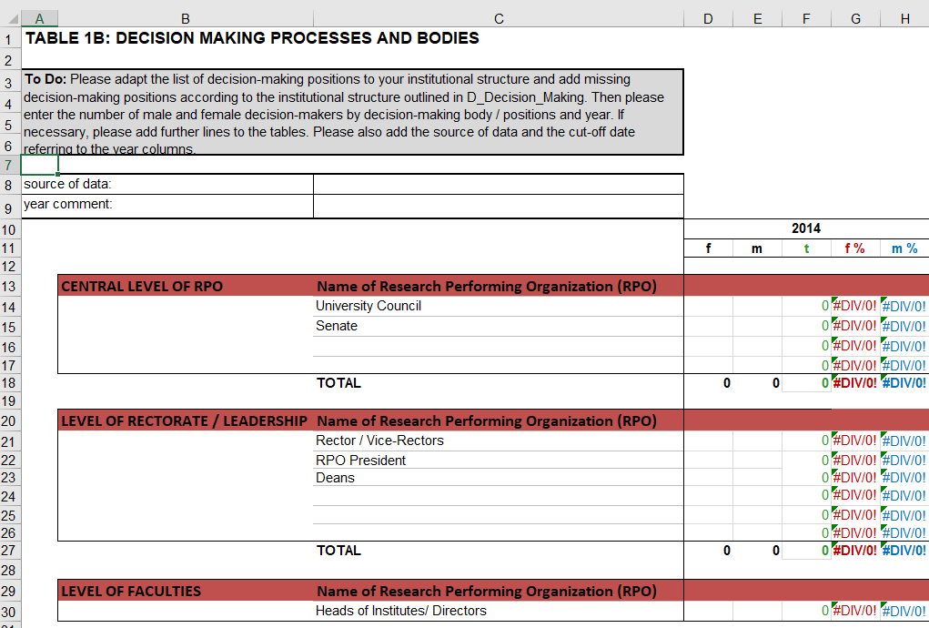
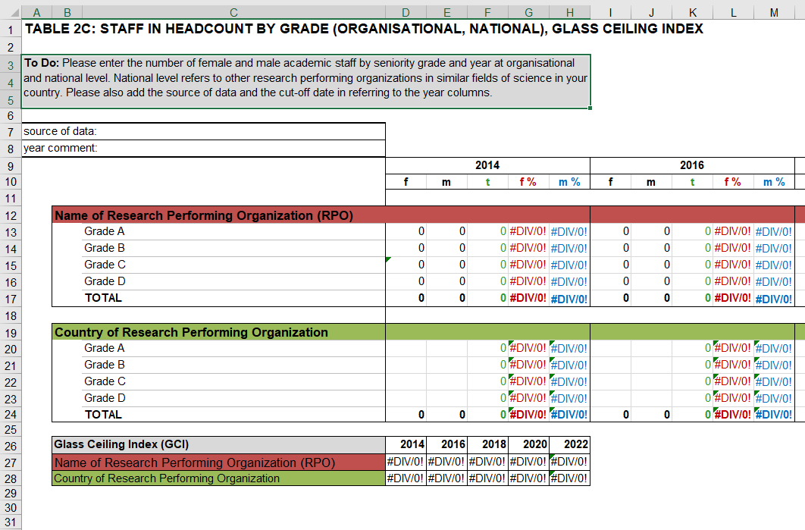
Step-by-Step Guide - Step IV
Before entering the sex-disaggregated data, read the instructions in the ‘To Do‘ box in each sheet. It contains helpful instructions.

Slide 13
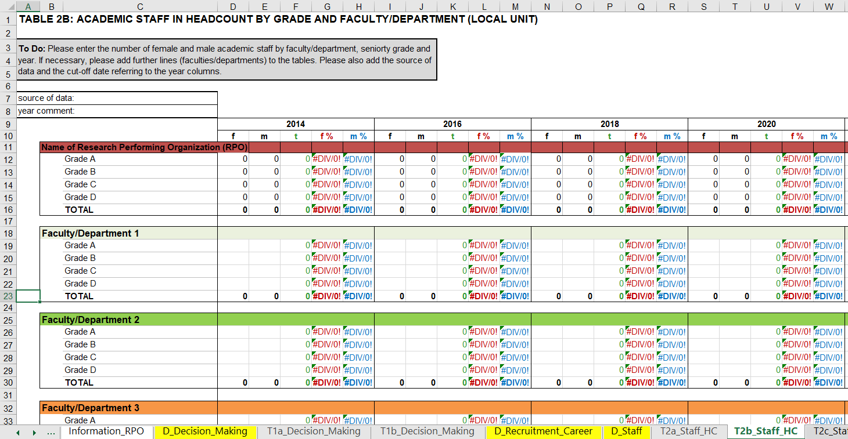
Step-by-Step Guide - Step V
Now you can start entering the collected data in one sheet after the other, e.g., starting off with the sex-disaggregated data on academic staff. If you only use some of the sex-disaggregated indicators, you can delete the sheets you won’t use.

Slide 14
Step-by-Step Guide - Step VI
Requirement of this last step is that you developed and implemented a gender equality plan (GEP) at your research performing organization.
If your RPO implements a GEP, you can use the final sheet ‘T8_GEProcess’ for monitoring the process of your GEP implementation.
As for the other parts of the GEECCO Data Monitoring Tool, please read the description sheet ‘D_GEP‘ before using the table for monitoring the process of your GEP implementation.

Slide 15
Monitoring: Process of GEP Implementation

Slide 16
Overview: Relevant Indicators for Gender Analysis
Decision-making positions and bodies
Number of applicants / nominees by sex, decision-making body / positions and year
Number of decision-makers by sex, decision-making body / positions and year
Recruitment and Career Development
Number of academic staff by sex, faculty/department, seniority grade and year
Number of academic staff by sex, seniority grade and year at organisational and national level
Number of academic staff by sex, form of employment/contract, faculty/department, and year
Number of allocated funds, bonus and allowances by sex, faculty/department, and year
Number of PhD/Doctoral students and graduates by sex, faculty/department, and year at organisational and national level
Number of bachelor and master first semester students enrolled by sex, faculty/department, and year
Number of bachelor and master graduates by sex, faculty/department, and year at organisational and national level
Gender Dimension in Research and Teaching
Number of publications of your RPO literature database including a gender component, by faculty/department
Number of bachelor and master programs with a gender component at your RPO

Slide 17
Background Information – Tutorial Development
The GEECCO Data Monitoring Tool results from the evaluation exercise within the framework of the Horizon 2020-funded project "Gender Equality in Engineering through Communication and Commitment" (GEECCO).
GEECCO aims to establish tailor-made Gender Equality Plans (GEPs) in four European universities (RPOs) and to implement the gender dimension in two research funding organisations (RFOs) in funding schemes, programmes and review processes.
The GEECCO partner RPOs collected sex-disaggregated data at two points of time in course of the summative evaluation by GESIS. The GEECCO Data Monitoring Tool entails the collection of monitoring indicators of this summative evaluation.
Limitation: The GEECCO Data Monitoring Tool was developed for universities located in the STEM (Science, Technology, Engineering, and Mathematics) field, therefore it does not claim completeness for other forms of RPOs.

Slide 18
Created by
Claudia Schredl
GESIS - Leibniz Institute for the Social Sciences
Center of Excellence Women and Science (CEWS)
Unter Sachsenhausen 6-8
50667 Cologne, Germany
claudia•schredl[at]gesis•org
Within the Framework of the Horizon 2020-funded Project
Gender Equality in Engineering through Communication and Commitment (GEECCO)
Grant Agreement Number 741128
funded by
the European Commission

